Slide 1
Library Operations
Group 4
Logan Fish, Ethan Ade, Brandon Lee

Slide 2
Application Motivation
Our Application Serves to update a Library's Database and Operating functionality. . ​
The Purpose of Updating The library's Database is to prepare it for more convenient usage in the current era by Patrons and Staff. ​
Most libraries are outdated in their use of technology and recordkeeping. Our desire was update their database to keep up with modern libraries Search methods, record keeping, and event data.
The modified database has more elements using recommendations, library events, employee reminders, and new categories besides basic library operations.
​
​
​
​
​
​
Notes:
Logan

Slide 3
Database Operations
The Database Stores Records of items, members, employees, events, transactions, and reviews.
Items are tracked by who checked them out, and when.
Events hold information about assigned employee, required items, and date.
Members hold information about member’s name, birthdate, phone number, email.

Slide 4
Tables With Some of their Important Attributes
Member Table: Member ID, MemberName, Gender, Birthday, Contact Info.
Item Table: ItemID, Title, Type (CD/Book/Movie/etc.) , Publisher, Number, etc.
Review Table: ReviewID, The Review, ItemID (to connect to the item)
Employee Table: EmployeeID, Name..
Events Table: EventId, EventName, Working Employee, Item being used, date, time.
Borrowing: BorrowID, dateBorrowed, Returned, itemID, MemberID.
Transaction: TransID, Name, Date, MemberID, BorrowingID. (Record of the Transaction).
Transaction Report: ReportID, ReportDate, TransactionID, BorrowingID
Notes:
The Tables listed do not have all of the following added attributes, but are some of the important ones listed to give off a general idea of why these tables are being used.

Slide 5
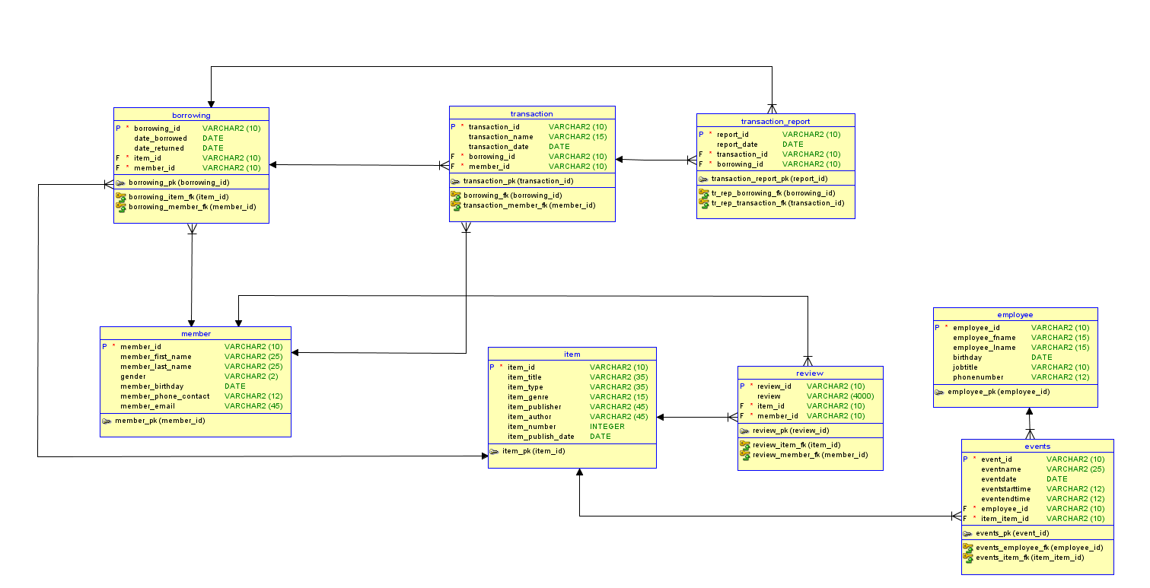
Tables and Structure
Notes:
Basic Relational Diagram of the Tables within the Database.

Slide 6
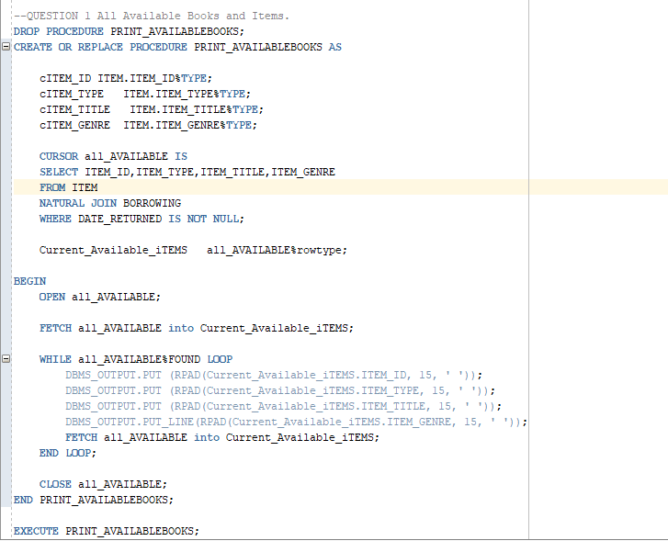

Question 1 - Can you view all the available items?
We thought being able to list off all the available items alongside what they are would be a useful thing to a User.

Slide 7
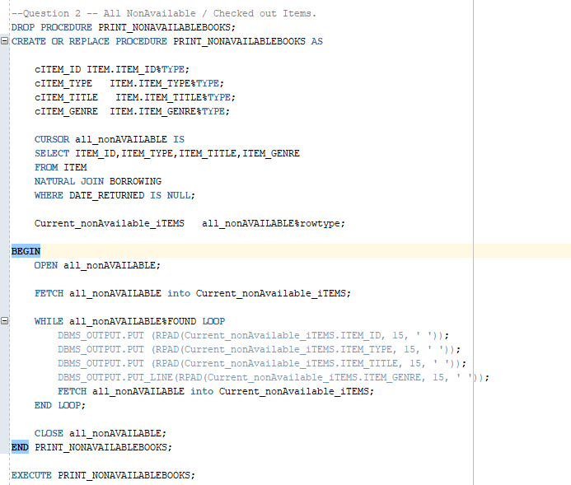

Question 2 - Can you view all the not available items?
We thought being able to list off all the NOT available items alongside what they are would be a useful for users and employees to see what is not currently available.

Slide 8
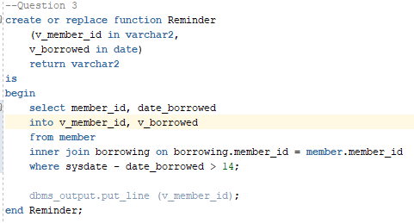
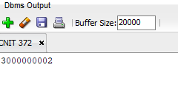
Question 3 Records of Overdue Books/Movies/Items
This can be something that pulls from the items and records table of all items passed the current date (return date) of at least 2 weeks. (Package Spec) (Package Body starts and continues in question 8)

Slide 9
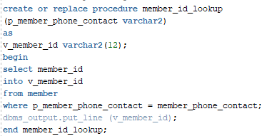


Question 4 Using a members phone number what is their id #?
-We thought this would be useful for when a member forgets their ID card and is trying to check out an item

Slide 10
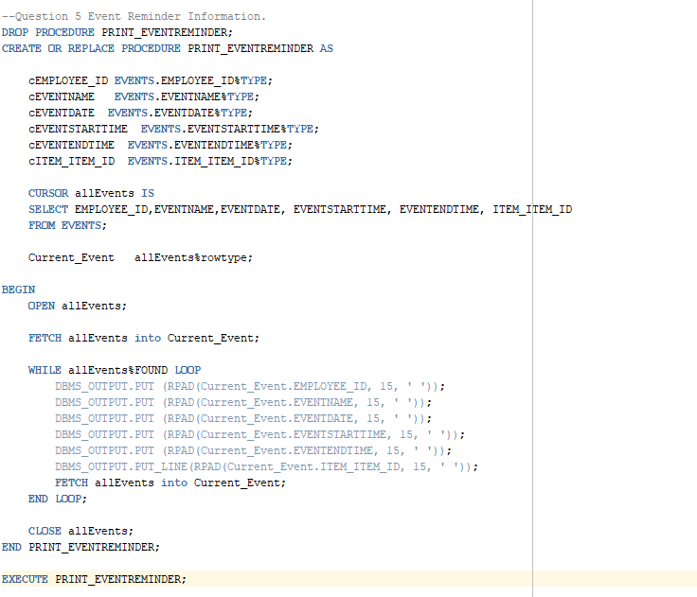

Question 5 - How will employees know of events & what's needed?
Pulls all relevant information from the Event Table into a dedicated view for the Employee to keep track of everything needed for Events.

Slide 11
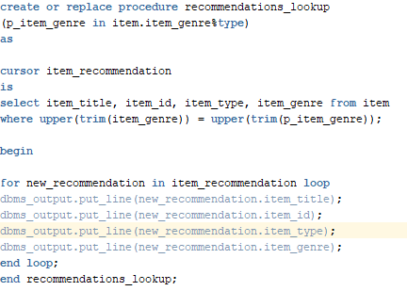
Question 6 - Can you Lookup recommendations?
Notes:
Function that pulls a search box up, entre in desired genre and it’ll pull from all available books of that genre.

Slide 12
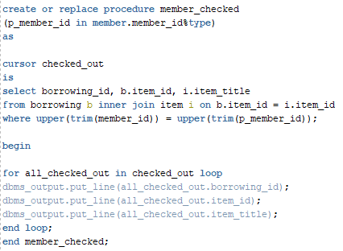
Question 7 - Using a members ID what items do they have checked out?

Slide 13
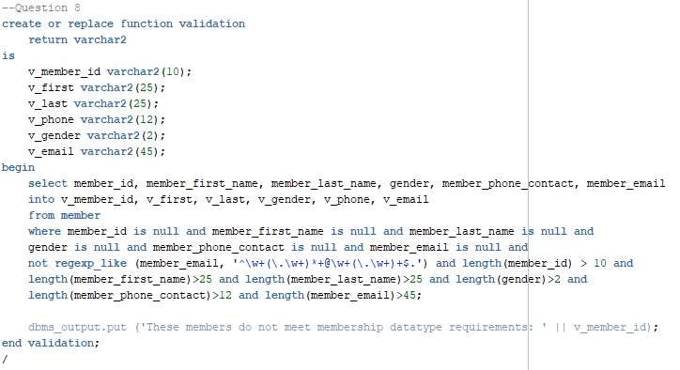
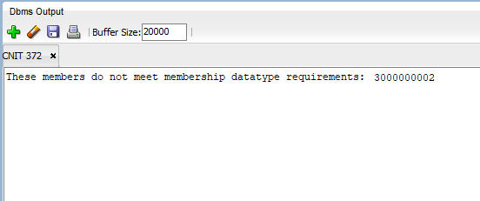
Question 8 Can members be denied?
Can members be denied if their application has issues?

Slide 14
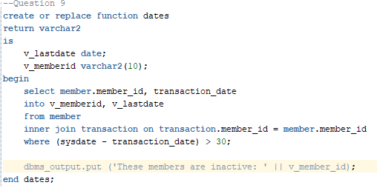
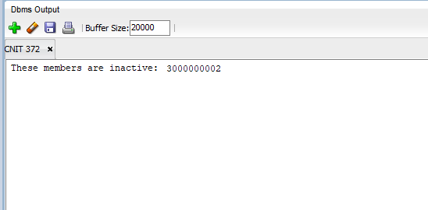
Question 9 - Can you see inactive members?
Pulls inactive member ids when their last transaction date was over 1 month

Slide 15
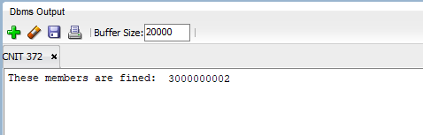
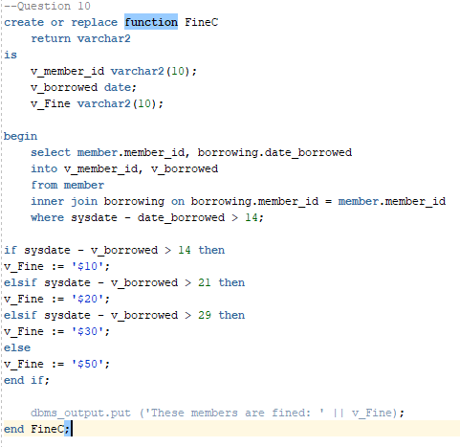
Question 10 Can a member be fined for late returns?
Fining members for late returns by days. Fire when new members are added and email. (Triggers), (End of Package)

Slide 16
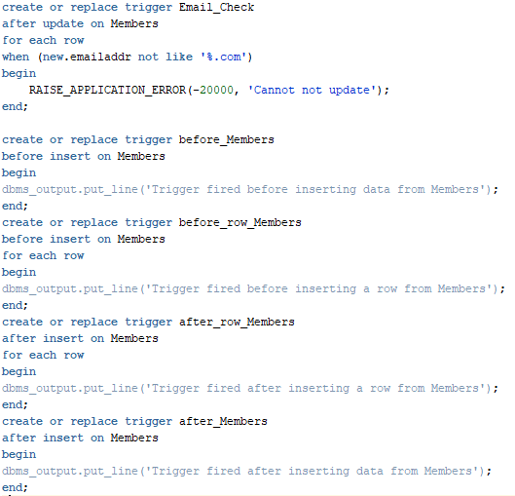

Slide 17
Thanks for Listening!

